Slide 1

A SIMPLE COMPUTERIZED DAILY SALES LOG SYSTEM FOR THE SCHOOL CANTEEN

Slide 2

1.1 Introduction
The school canteen is an essential part of the school community, it provides meals and
snacks to students and staff throughout each day. However, most canteens still rely on using
manual methods such as notebooks or paper to record daily sales. This often results in
inaccurate records, miscalculation, and disordered data, making it difficult to monitor daily
income and financial performance. These problems create inefficiency and make monitoring
sales more time consuming for canteen staff.
This situation led to the development of this study, which aims to address the problems
of manual sales recording and reporting. The study focuses more on making the sales process
easier and more accurate by replacing the manual recording of sales. It’s an important topic for
the school community because it helps modernize canteen operations. Through efficient and
accurate sale monitoring it ensures transparency, accountability, and better decision making
for school administrator and canteen staff.
The main objective of this research is to develop a Simple Computerized Daily Sales
Log System for the school canteen that automatically records daily sales by asking the user to
input the product sold, quantity and the price per unit. This will help minimizes human errors,
and ensures accurate reports. Through this system, the canteen can achieve faster transactions,
organized data, and more efficient management of daily operations.

Slide 3
1.2 Statement of the Problem
General Problem
The main problem address by this study is the inefficiency of manual sales recording in the school canteen. Manual recording, computation and paper-based monitoring often cause errors, loss of data, and slow reporting. To solve these issues, a Simple Computerized Daily Sales Log System will be developed to help record and summarize daily sales automatically.
Specific Problem
Frequent errors in manual computation and recording Manual recording and computing daily total sales can lead to mistakes due to human error.These inaccuracies make it difficult to track actual income correctly at the end of each day.
Lack of an organized and quick way to summarize daily sales. Canteen staff have to manually add up each transaction to determine daily totals, which is time-consuming. The absence of an automated summary feature slows down reporting andmakes data review less efficient.
Difficulty in maintaining and organizing sales records. Sales data written on paper or notebooks are prone to loss and disorganization. The system addresses this issue by allowing transactions to be stored digitally during a session, enabling easier viewing and management of sales information.

Slide 4
1.3 General Objectives
The general objective of this study is to develop a simple computerized daily sales log system using basic Python programming concepts to help the school canteen record, monitor, and compute daily sales efficiently, reducing errors caused by manual recording.
1.4 Specific Objectives
  Design and develop a program that allows the canteen staff to input, store, and manage sales transactions in a list format.
  Automate the computation of total daily sales to minimize human error and save time in generating sales summaries.
  Allow viewing and editing of sales records within a single session to ensure data accuracy and flexibility.
  Demonstrate the application of basic programming concepts (such as lists, loops, and functions) in solving real-life problems related to business operations.
  Evaluate the efficiency and usability of the system based on feedback from canteen staff and school administrators.

Slide 5
1.5 Scope and Limitation
  The system allows canteen staff to input daily transactions including the product name, quantity, and price.
  The system automatically calculates the total sales based on the data entered.
  Users can view all recorded sales in list form during the session.
  The system provides basic options to edit sales records within the same session.
  It can summarize daily transactions and show the total amount earned for the day.
  The program operates in a simple text-based interface using Python, suitable for beginner-level implementation.
  The system is designed for use by canteen staff at a time on a standalone computer.
  The study emphasizes how fundamental programming concepts (lists, loops, and functions) can be applied to solve real-life problems like sales monitoring.
Limitation
The system does not include login features to start the process and is accessible only to the canteen staff for the purpose of recording, computing and monitoring daily sales. The system also does not support database integration since it only uses basic programming concepts such as list, loops and functions to temporarily store the data. This means the data will be lost once the program is closed. It also does not feature inventory management, barcode scanning, or automated report exporting. The functionality of this system focuses only on daily sales within one session. These limitations define the project as a basic educational tool rather than a full-scale commercial sales system.

Slide 6
1.6 System Requirements
A. Software Requirements:
  Programming language: Python
  Operating System: Windows 10 or 11
  Other Tools:
Flowchart Maker (Draw.oi)
Text editor (MS Word)
B. Hardware Requirements:
  Computer/Laptop
  Input Devices: Keyboard, Mouse
  Output Devices: Screen

Slide 7
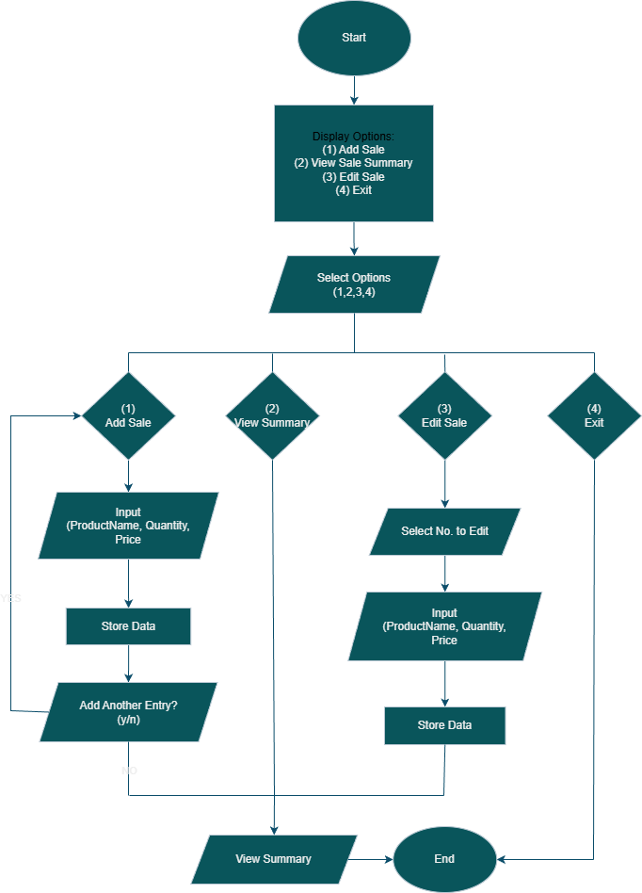
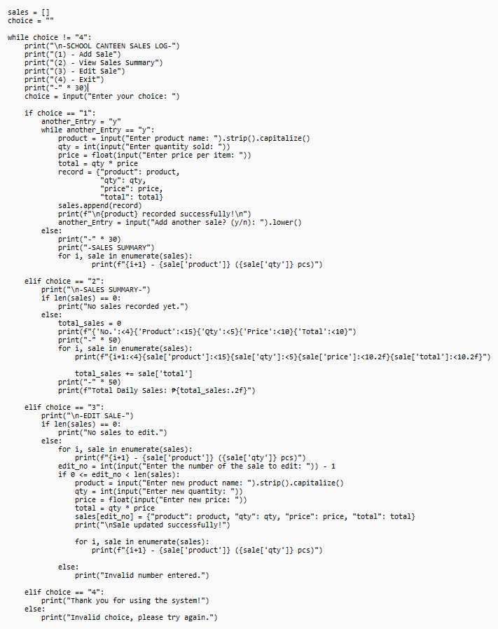
A. Flowchart
B. Code Snippet

Slide 8
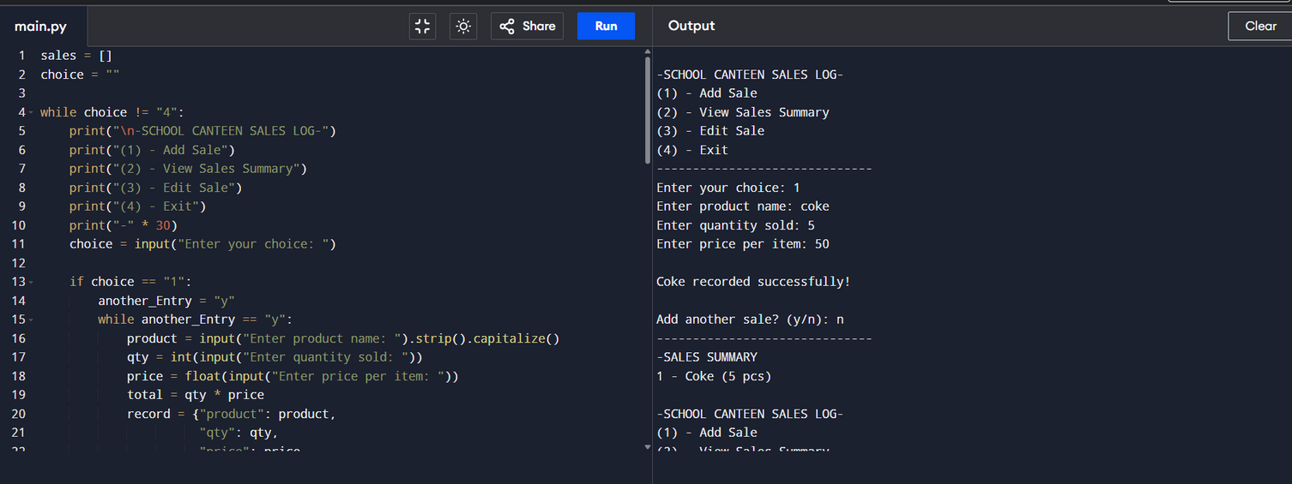
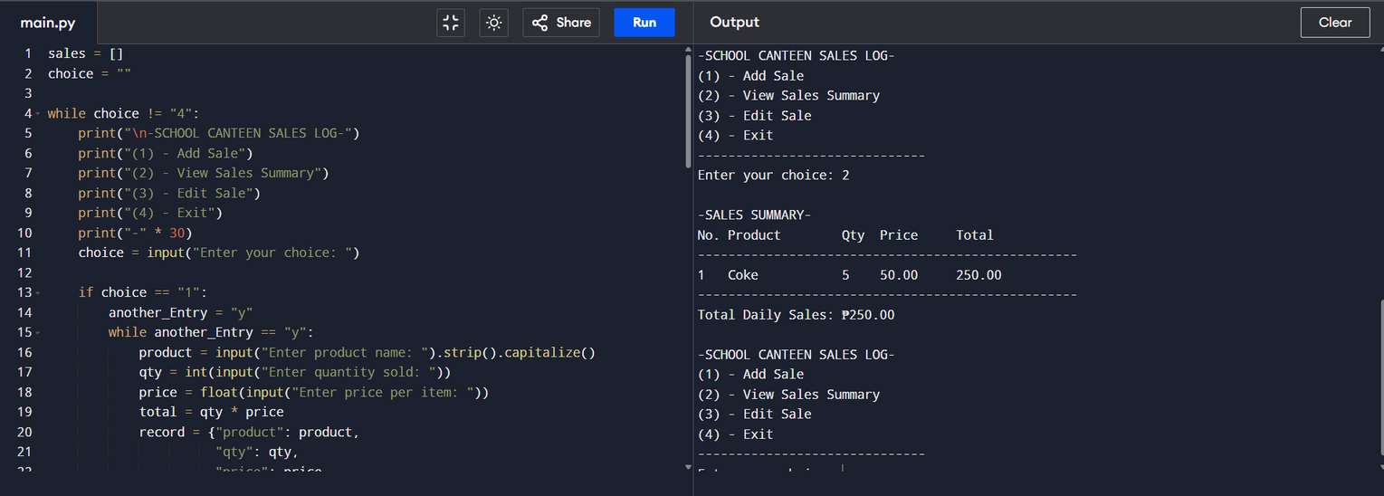
C. Testing

